Slide 1

Hospital Operation Analytics
Presented By:
Mohit Chaudhari & Monesh Chaudhari
Batch No.: 509

Slide 2

About me
Educational Background : B.Tech (Computer Science and Engineering)
Want to learn Data Science because It allows me to turn raw data into meaningful insights that can solve real-world problems. In today’s digital world, data is everywhere, and I’m interested in understanding patterns, trends, and making data-driven decisions rather than relying on assumptions.
LinkedIn
GitHub

Slide 3
Objectives of the Project
01
Design a relational database for hospital patient care operations
02
Import and manage structured hospital data using MySQL
03
Analyze patient and appointment demand by city, service, priority and channel
04
Understand appointment behaviour and frequently active patients
05
Evaluate treatment outcomes, waiting time and duration
06
Assess doctor workload and room utilization
07
Identify cancellations, no-shows, rescheduling and repeat attempts
08
Derive insights with joins, aggregations, filtering and subqueries

Slide 4
Business Scenario
To understand patient demand and appointment patterns across different cities and service types.
To analyze patient behaviour and appointment activity for better patient service planning.
To evaluate treatment performance based on outcomes, waiting time, and treatment duration.
To assess doctor workload and room utilization for better resource management.
To identify operational issues such as cancellations, no-shows, rescheduling, and multiple treatment attempts.
To use SQL-based insights to support better scheduling, staffing, and operational decision-making.

Slide 5
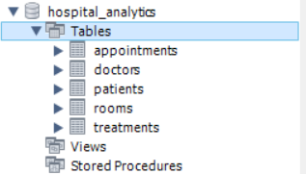
Dataset & Database Overview
Synthetic hospital dataset with 5 relational tables.
400 Patients | 3,000 Appointments | 3,500 Treatments | 80 Doctors | 50 Rooms
Data managed and analyzed using MySQL.
Primary & Foreign Keys connect the tables.
CSV data imported and verified before analysis.
Used SQL techniques like JOIN, GROUP BY, COUNT, SUM, and AVG

Slide 6
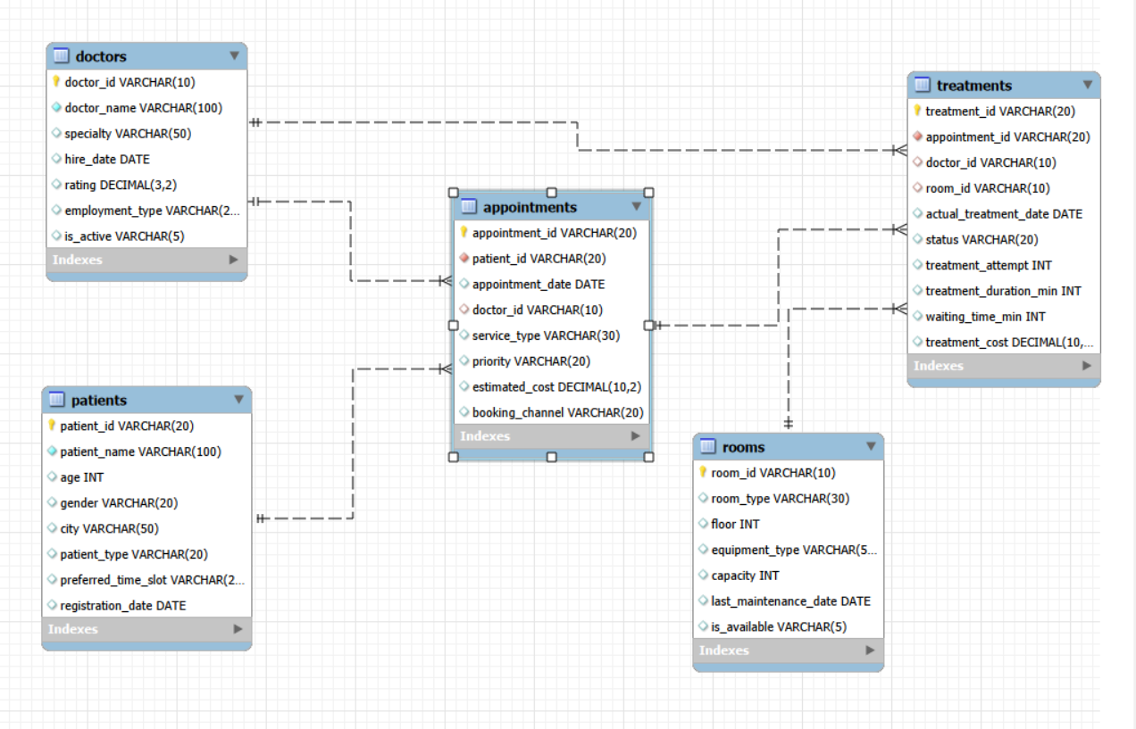
ER Diagram

Slide 7


Objective-Based Analysis
3. Basic Analysis / Data Exploration
The hospital database contains a total of 400 patients.
The COUNT(*) function counts all records in the patients table.

Slide 8
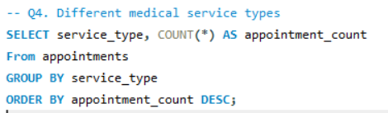
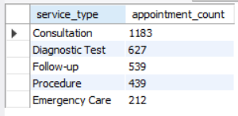
Consultation has the highest appointment volume, with 1,183 appointments.
Diagnostic Test ranks second with 627. appointments, followed by Follow-up with 539.
Procedure accounts for 439 appointments, while Emergency Care has the lowest count at 212 appointments.

Slide 9
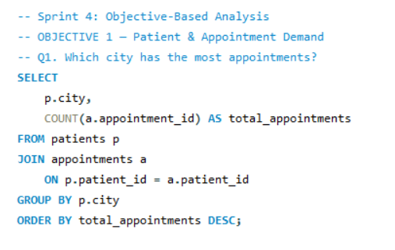
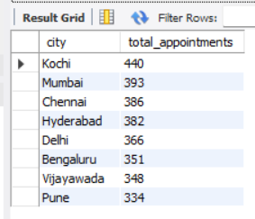
4.1 Understand Patient and Appointment Demand
Kochi has the highest appointment volume with 440 appointments.
Mumbai is second with 393 appointments, followed by Chennai with 386.
Pune has the lowest appointment count among the displayed cities, with 334 appointments.
The variation indicates different levels of patient demand across cities.

Slide 10
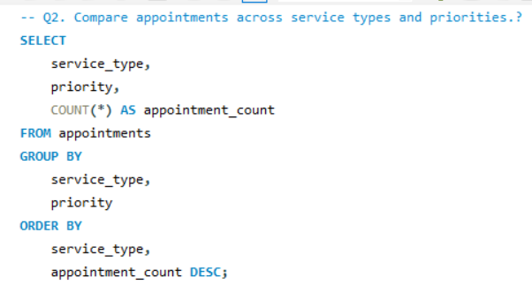
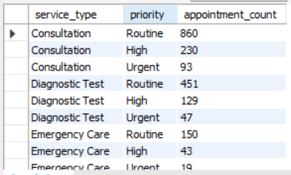
Consultation has the highest appointment volume, with 1,183 appointments.
Diagnostic Test ranks second, with 627 appointments.
Emergency Care has the lowest appointment count among the displayed service types, with 212 appointments.
Routine appointments are the most common across all service types, indicating higher demand for routine healthcare services.

Slide 11
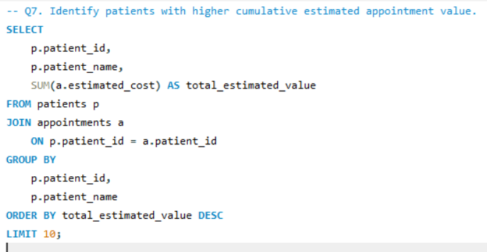
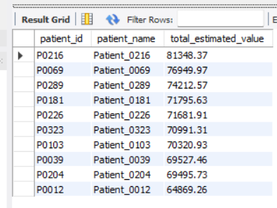
4.2 Understand Patient Appointment Behaviour
P0216 has the highest cumulative estimated value (81,348.37).
The query identifies the top 10 patients by estimated appointment value.
Higher values indicate patients with greater cumulative estimated appointment costs.
This helps understand patient-level appointment value patterns.

Slide 12
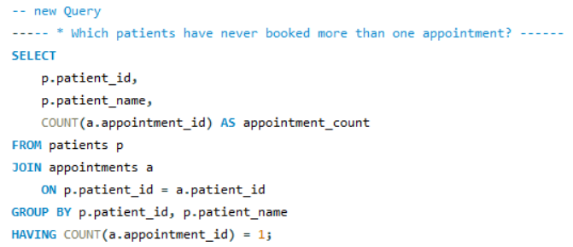
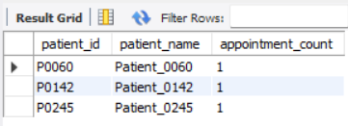
The query identifies patients with exactly one appointment.
P0060, P0142, and P0245 are examples from the output.
These patients represent single-appointment activity.
The result helps analyze patient engagement and booking behaviour.

Slide 13
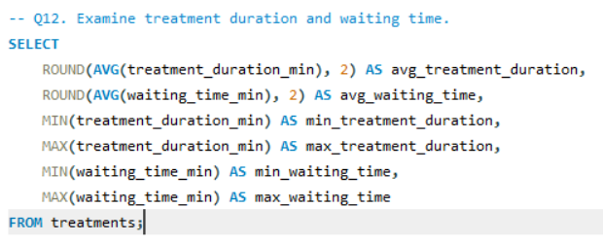

4.3 Evaluate Treatment Performance
The average treatment duration is 38.72 minutes, while the average waiting time is 15.62 minutes.
The minimum treatment duration is 5 minutes, and the maximum is 173 minutes.
Waiting time ranges from 0 to 90 minutes.
These insights help evaluate patient waiting times and treatment efficiency in hospital operations.

Slide 14
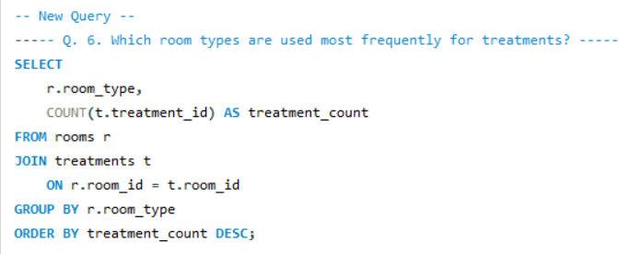
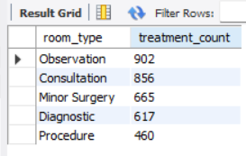
Observation rooms have the highest usage (902 treatments).
Consultation rooms are the second most frequently used.
Procedure rooms have the lowest usage among the listed types.
The result helps understand room utilization and resource demand.

Slide 15
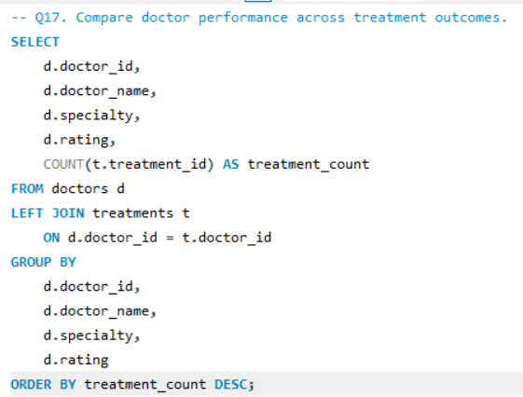
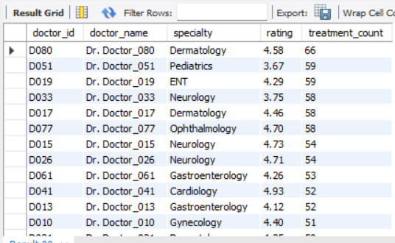
4.4 Understand Doctor and Room Performance
Dr. Doctor_080 has the highest displayed treatment count (66).
The output compares doctor workload across specialties.
Doctor ratings are displayed along with treatment assignments.
The analysis helps understand doctor workload distribution.

Slide 16
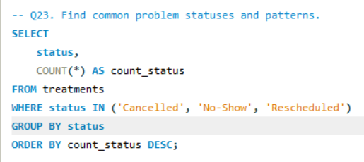
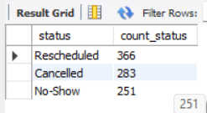
4.5 Identify Treatment and Appointment Problems
Rescheduled cases are highest (366) among the identified problem statuses.
Cancelled cases total 283.
No-Show cases total 251.
These patterns highlight areas for better appointment management.

Slide 17
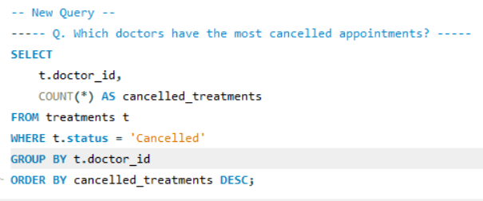
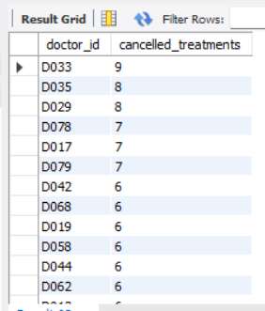
D033 recorded the highest cancellations (9).
D035 and D029 follow with 8 cancellations each.
Several doctors have cancellation counts between 6 and 7.
The output helps identify cancellation patterns by doctor.

Slide 18
Overall Key Findings
01
Patient demand varies across cities, service types, priorities and booking channels.
02
Patient behaviour differs by patient type, appointment frequency and booking pattern.
03
Appointment performance varies by waiting time, priority, status and service type.
04
Doctor workload varies across specialties, appointments and treatment assignments.
05
Cancellations, no-shows and rescheduling show where appointment management can improve.
06
SQL analysis uncovers patterns that support better operations and resource management.

Slide 19
Conclusion
Developed a relational healthcare database to manage patients, doctors, appointments, treatments, and rooms.
Used SQL analysis to identify important patterns in patient demand, appointments, treatments, and resource utilization.
Analyzed waiting times, treatment outcomes, cancellations, no-shows, and multiple treatment attempts to identify operational areas requiring attention.
The project demonstrates how SQL can transform healthcare data into meaningful business insights for better operational planning.
The analysis provides data-driven insights that can help improve appointment scheduling, resource allocation, and overall hospital operations.

Slide 20


Slide 21

THANK YOU

